Slide 1


Potability test of water
By- Rupali Gulave
PGA-35
IMARTICUS

Slide 2
Introduction
Water is an inorganic compound with the chemical formula H2O.
Potable water , also known as drinking water, comes from surface and ground sources.
Non-potable water is not suitable for drinking.
Microbiologically contaminated drinking water can transmit diseases such as diarrhoea, cholera, dysentery, typhoid and polio and is estimated to cause 4,85,000 diarrhoeal deaths each year. (According to WHO)

Slide 3
OBJECTIVE
“Developing a model to predict the potability of water based on various parameters such as pH level, hardness, turbidity, and conductivity.”

Slide 4
PROCESS FLOW
DATA COLLECTION
DATA PRE-PROCESSING
TRAIN – TEST SPLIT
MODEL BUILDING
(DT, RF,GB,XG)
MODEL SELECTION
CONCLUSION

Slide 5





TOOLS AND PLATFORM USED
Tools : Python
Platform : Jupyter Notebook
Library Used : Numpy, Pandas, matplotlib, seaborn, Scikit-learn

Slide 6
Source of the data – www.kaggle.com
DATA DESCRIPTION
ph | ph value (0-14)
Hardness | Amount of dissolved minerals, particularly calcium and magnesium ions, in the water(ppm)
Solids(TDS) | Solids in water refer to any material or substance that is present in water in a solid form(mg/l)
Chloramines | Chloramines are a group of chemical compounds that are formed by the reaction of chlorine and ammonia in water(ppm)
Sulfate | Sulfate is a common chemical compound that can be found in water(mg/l)
Conductivity | ability to conduct an electric current(µS/cm -microsiemens per centimeter)
Organic_carbon | amount of carbon that is present in the water in an organic form(mg/l)
Trihalomethanes | Trihalomethanes (THMs) are a group of disinfection byproducts that can form when chlorine or other disinfectants are used to treat drinking water(ppm)
Turbidity | Turbidity is a measure of the clarity of water and the degree to which light is scattered or absorbed by particles in the water(0-100 NTU-nephelometric turbidity units)
Potability | Potability refers to the suitability of water for human consumption(1-potable/ 0- non-potable)

Slide 7
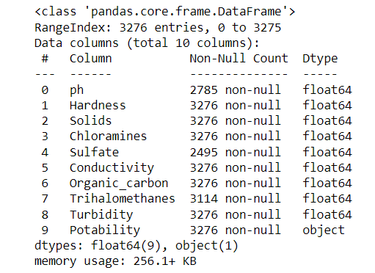
Data pre-processing

Slide 8
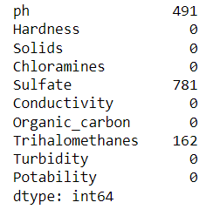
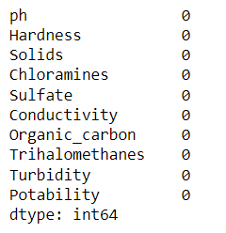
MISSING VALUES
REPLACED MISSING VALUES BY MEDIAN

Slide 9
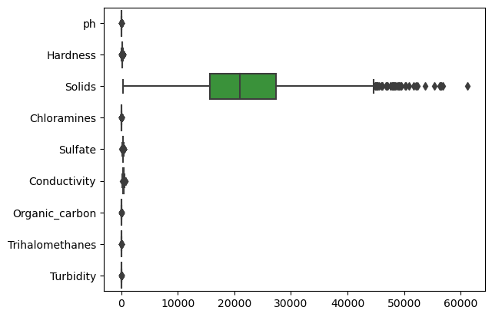
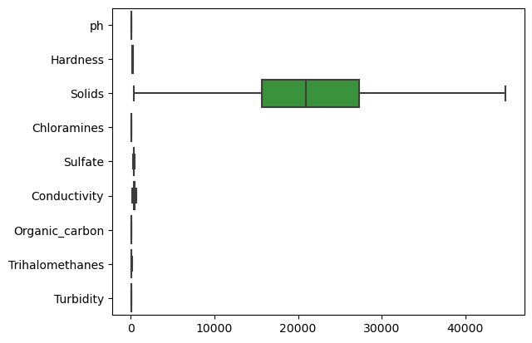
OUTLIERS
TREAT OUTLIERS USING
WINSORIZING TECHNIQUE

Slide 10
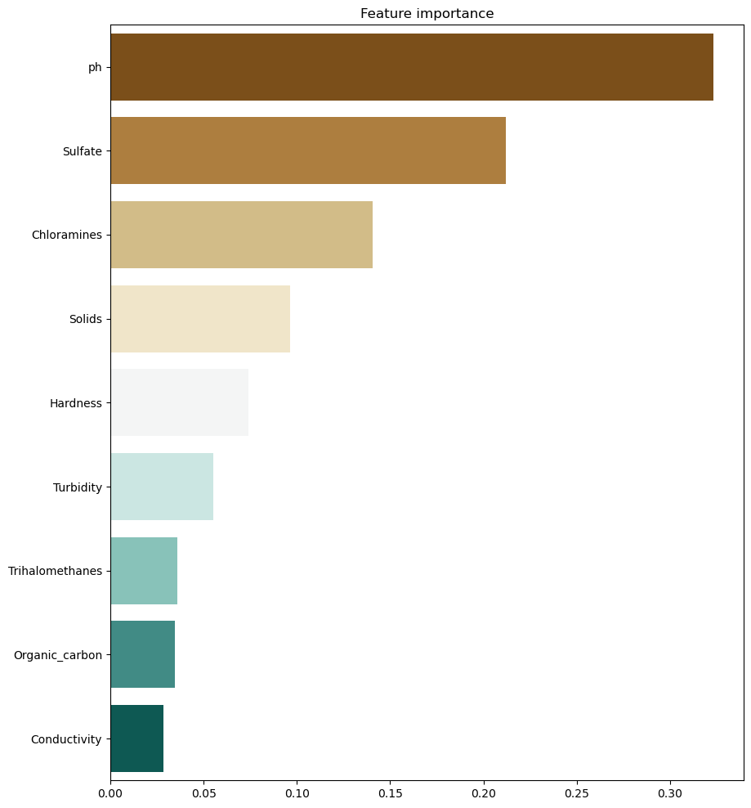
IMPORTANT VARIABLE
In a Dataset the most important variable is ph
It is an important factor to consider when assessing the safety of drinking water.
However, it's important to keep in mind that other factors, such as Sulfate, total dissolved solids, and bacterial contamination, may also be important in determining water potability.

Slide 11
TRAIN-TEST SPLIT

Slide 12
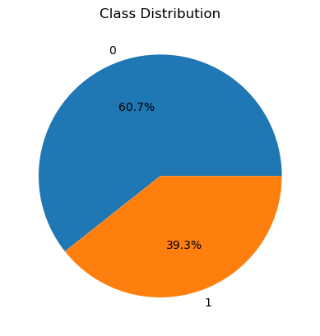
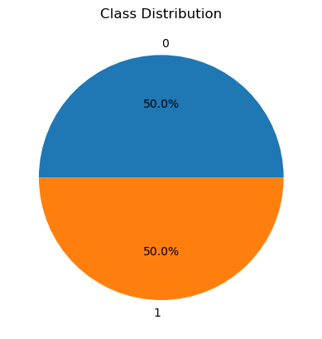
Challenges- CLASS IMBALANCE
Class balancing using SMOTE Technique

Slide 13
MODEL BUILDING
Decision Tree
Overfit
100% accuracy
Gradient Boosting
Train-85%
Test-88%
Xg Boosting
Train-80%
Test-78%
Random Forest
Train- 72%
Test- 71%
After Pruning
Train – 70%
Test- 69%

Slide 14
MODEL SELECTION
SR NO. | MODEL | ACCURACY(TRAIN) | ACCURACY(TEST)
1. | DECISION TREE | 75% | 65%
2. | RANDOM FOREST | 72% | 71%
3. | GRADIENT BOOSTING | 85% | 88%
4. | EXTREME BOOSTING | 80% | 78%
Here we select Extreme boosting as a Best model with High accuracy
XGBoost is less prone to overfitting than decision trees and random forest. It achieves this by using regularization techniques such as L1 and L2 regularization, which penalize the complexity of the model
XGBoost has the ability to handle imbalanced datasets, where one class is represented more than the other.

Slide 15
Conclusion
The important variables in our Dataset is ph, sulfate, chloramines,solids.
Water with ph value 6.5-8.5, sulfate content- 250-500 mg/l, chloramines content- 4 ppm, solids(TDS)- 500=100 mg/l is Drinkable(Potable Water).
Various methods to treat water are:-
1) Coagulation and Flocculation
2) Sedimentation
3) Filtration
4) Disinfection

Slide 16
THANK you

